Slide 1
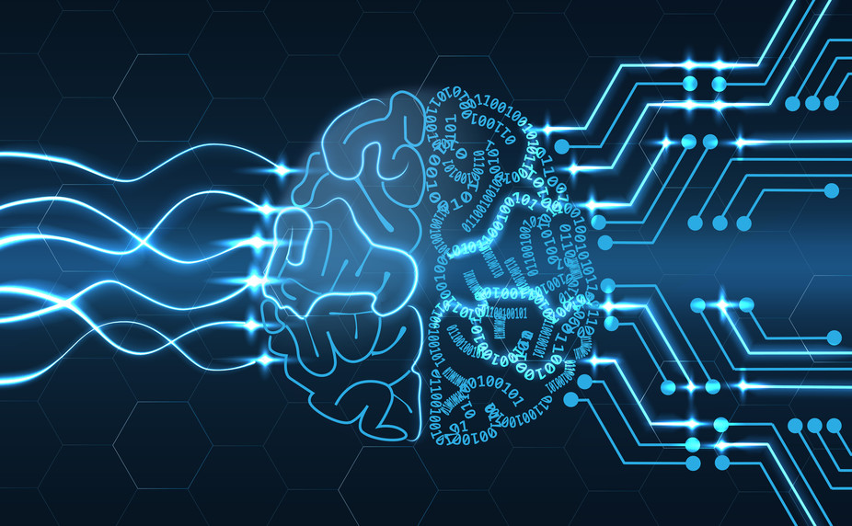
Pengantar Kecerdasan Komputasional

Slide 2
Deskripsi Matakuliah
Kode MK : EA234305
Nama MK : Kecerdasan Komputasional
Sks : 4
Semester : 3
Kelas : S1 RKA
Jadwal : Rabu, 12.30 – 14.10, Kamis, 09.40 – 11.20
Perkuliahan : 31 Agustus – 18 Desember 2026

Slide 3
Capaian Pembelajaran
Mahasiswa mampu menjelaskan konsep kecerdasan komputasional, konsep pembelajaran mesin, jenis pembelajaran, algoritma pembelajaran, dan penerapannya pada berbagai tipe aplikasi
Notes:
Capaian pembelajaran dari mata kuliah ini yaitu…

Slide 4
Materi
Pengantar Kecerdasan Komputasional, Pembelajaran Mesin
Introduction to Computational Intelligence Concepts
Propositional Logic
Predicate Logic
Inference
Introduction to Fuzzy Logic
Fuzzy Inference with Mamdani, Sugeno, Tsukamoto
Quantifying Uncertainty
Probabilistic Reasoning
Evolutionary Computation (Genetic Algorithm)
Swarm Intelligence (Particle Swarm Optimization)
Optimization (Grey Wolf / Whale)

Slide 5
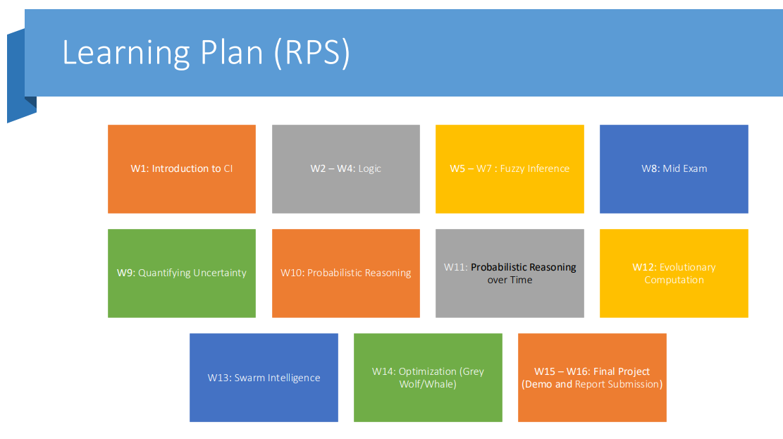

Slide 6
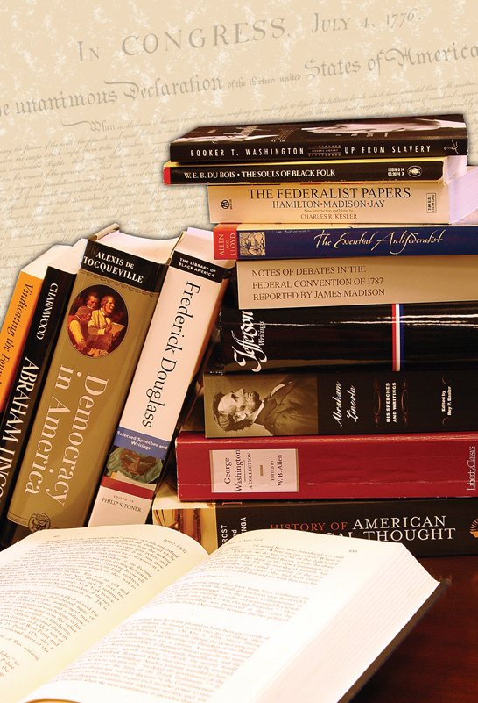
Referensi
Utama
  Christopher Bishop, Pattern Recognition and Machine Learning. Springer, 2006
  Andries P. Engelbrecht, Computational Intelligence An Introduction, Second Edition, John Wiley & Sons Ltd, 2007
  Rudolf Kruse, Christian Borgelt, Frank Klawonn, Christian Moewes, Matthias Steinbrecher, Pascal Held, Computational Intelligence: A Methodological Introduction, Springer, 2013
  Stuart Russel, Peter Norvig, Artificial Intelligence: A Modern Approach, Fourth edition, Pearson, 2020
Pendukung
  Michael Negnevitsky, Artificial Intelligence: A Guide to Intelligent Systems, Second Edition, Addison Wesley, 2002
  Arthur K. Kordon, Applying Computational Intelligence, Springer-Verlag Berlin Heidelberg 2010
  S. Sumathi, Surekha P., Computational Intelligence Paradigms: Theory and Applications using MATLAB, CRC Press, 2010
  Peter Harrington, Machine Learning in Action, Manning, 2012

Slide 7
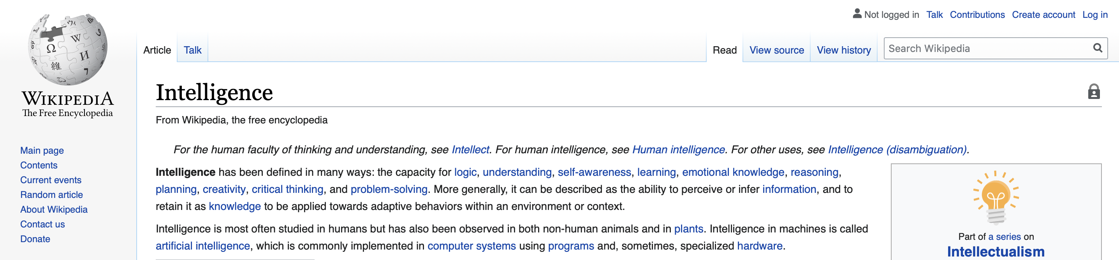
Apakah yang Dimaksud Kecerdasan?

Slide 8


Computational Intelligence
The expression computational intelligence (CI) usually refers to the ability of a computer to learn a specific task from data or experimental observation. Even though it is commonly considered a synonym of soft computing, there is still no commonly accepted definition of computational intelligence.
  Computational intelligence is a set of nature-inspired computational methodologies and approaches to address complex real-world problems to which mathematical or traditional modelling can be useless for a few reasons: the processes might be too complex for mathematical reasoning, it might contain some uncertainties during the process, or the process might simply be stochastic in nature.
  Computational Intelligence provides solutions for complicated problems.
  It primarily includes artificial neural networks, evolutionary computation and fuzzy logic.
  Also embraces biologically inspired algorithms such as swarm intelligence and artificial immune systems.
The theory, design, application, and development of biologically and linguistically motivated computational paradigms
  neural networks,
  genetic algorithms,
  evolutionary programming,
  fuzzy system,
  hybrid intelligent systems
Some definitions. https://www.andata.at/en/answer/artificial-intelligence-computational-intelligence-softcomputing-natural-computation-whats-the-difference.html

Slide 9
Teknik Kecerdasan Komputasional
Computational Intelligence Techniques
Fuzzy sets
Fuzzy Logic
Fuzzy Linguistic Modeling
Artificial Neural Networks
Artificial Immune System
Evolutionary Strategies
Feedforward Networks
Evolutionary Computing
Fuzzy Numbers
Hopfield Neural Networks
Backpropagation Neural Networks
Self Organizing Maps
Genetic Algorithms
Evolutionary Programming
Swarm Intelligence
Particle Swarm Optimization
Ant Colony Optimization
Bee Colony Optimization

Slide 10
Machine Learning
Machine learning is a branch of artificial intelligence that focuses on developing algorithms and computer models that enable systems to learn from data and previous experiences. The main goal of machine learning is to make computers able to understand patterns in data and make predictions or make decisions based on these patterns, without having to be explicitly programmed.

Slide 11
Artificial Intelligence
Computational Intelligence
Machine Learning
SVM
Genetic Algorithm
ANN
DT
K-means clustering
PSO
Fuzzy
First order logic
Searching Techniques

Slide 12
Ringkasan Sejarah Sistem Cerdas
1943 | McCulloch & Pitts: Model sirkuit boolean otak
1950 | “Mesin dan Kecerdasan Komputasi” Turing
1956 | Dartmouth meeting: "Artificial Intelligence" adopted
1952 – 69 | Harapan besar
1950s | Program AI awal, termasuk program checker Samuel, Ahli Teori Logika Newell & Simon, Mesin Geometri Gelernter
1965 | Algoritma Robinson untuk penalaran logis
1966 – 73 | AI menemukan kompleksitas komputasi, penelitian jaringan saraf hampir menghilang
1969 – 79 | Pengembangan awal sistem berbasis pengetahuan
1980 – | AI menjadi sebuah industri
1986 – | Jaringan saraf kembali populer
1990 – | Agen cerdas baru
1995 – | Komputasi Evolusioner, Swarm Intelligence, dan Komputer Generasi Baru

Slide 13

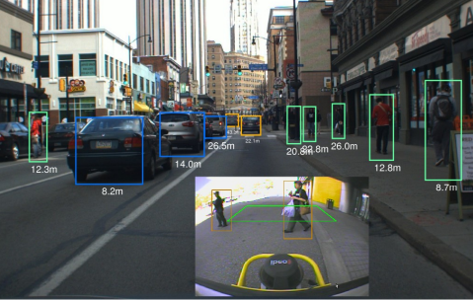
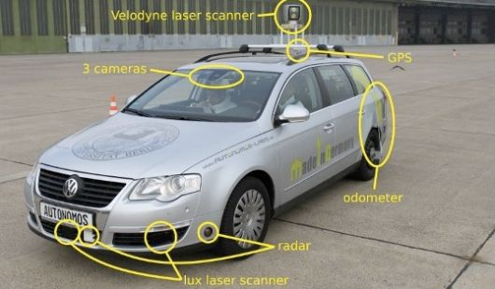
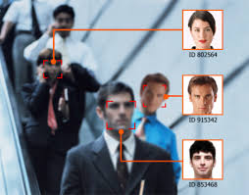
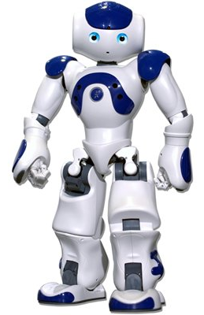
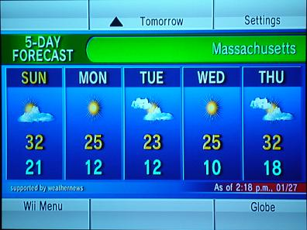
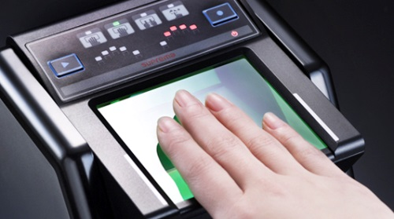
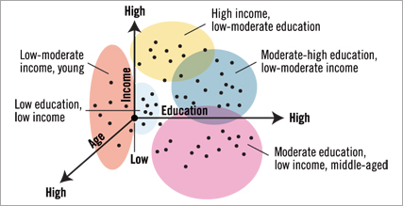
Contoh Aplikasi

Slide 14

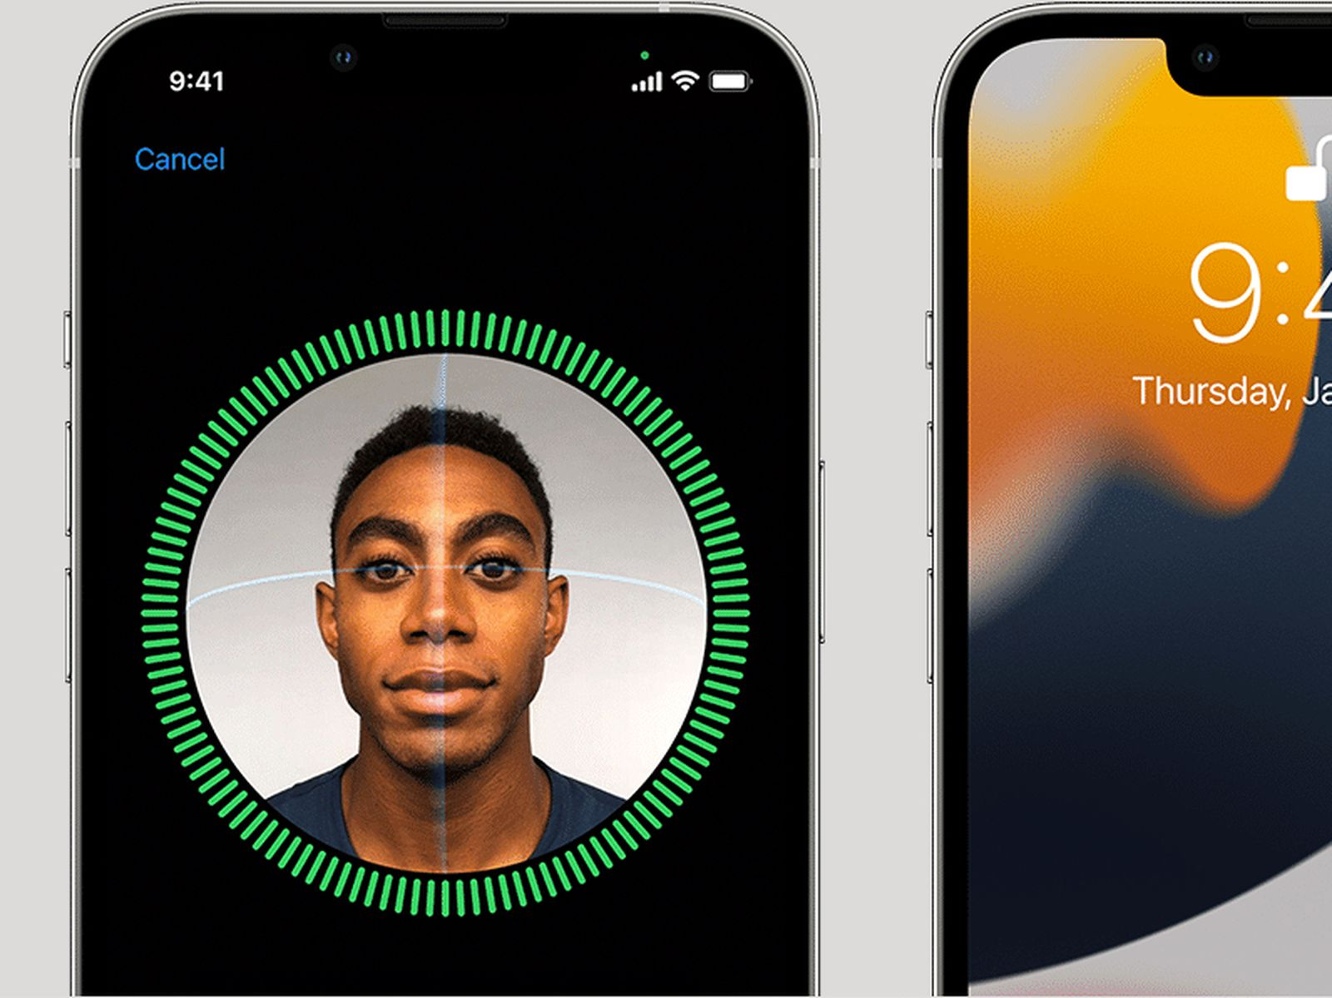

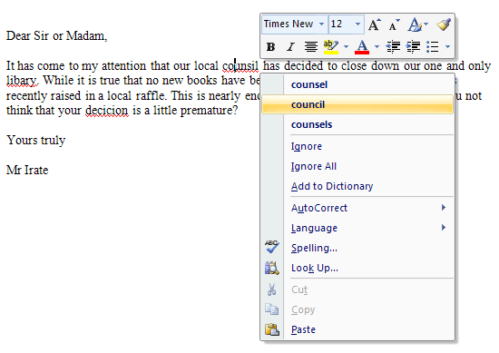
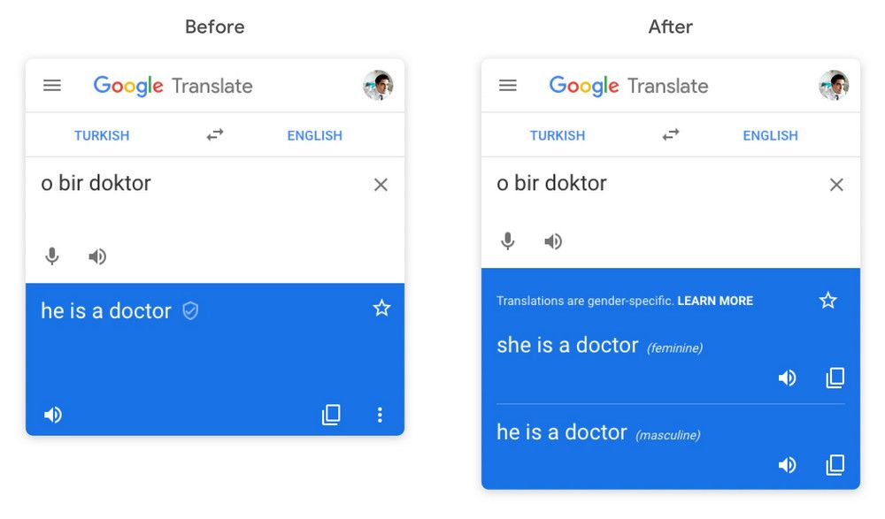
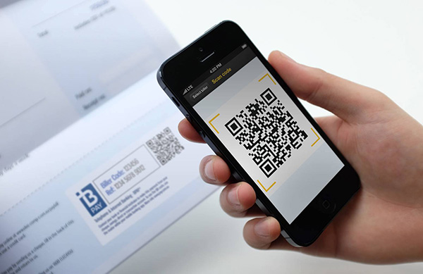

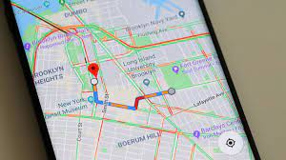
Contoh Aplikasi
Peta dan navigasi: Google Maps, Apple Maps, Waze
Asisten pribadi : Apple Siri, Google Assistant, Amazon Alexa, Samsung Bixby, dll
Penerjemah Bahasa: Google Translate, Microsoft Translator, iTranslate, dll
E-payment
Setting tayangan konten pada aplikasi media sosial
Editor tulisan: Microsost Word, Grammarly
Face-ID
Customer Service
  Pengenalan suara otomatis
  Chat box

Slide 15


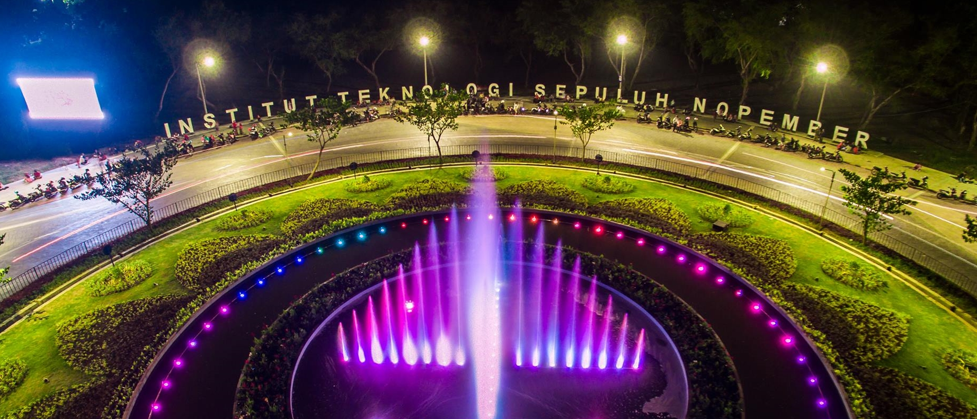
- TERIMA KASIH -

